Slide 1
June 13th Meeting
Ainsley Lai

Slide 2
Agenda
Spectrograms
OOI change in data storage → cannot query data
SPDF of near identical position/speed points
Restrict to EC and CC hydrophones, 2 MMSIs
Low data
AIS mapping

Slide 3
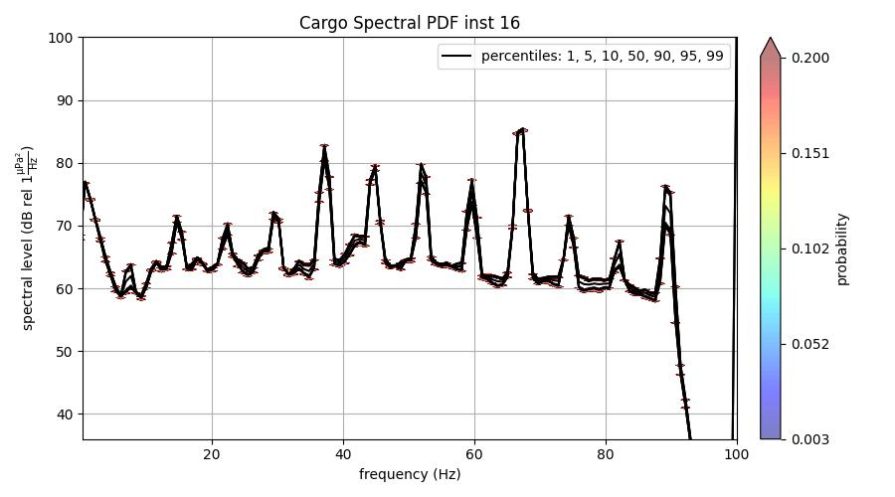

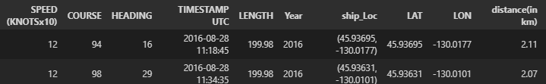
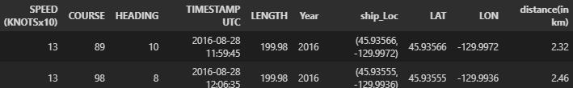
SPDF

